Slide 1

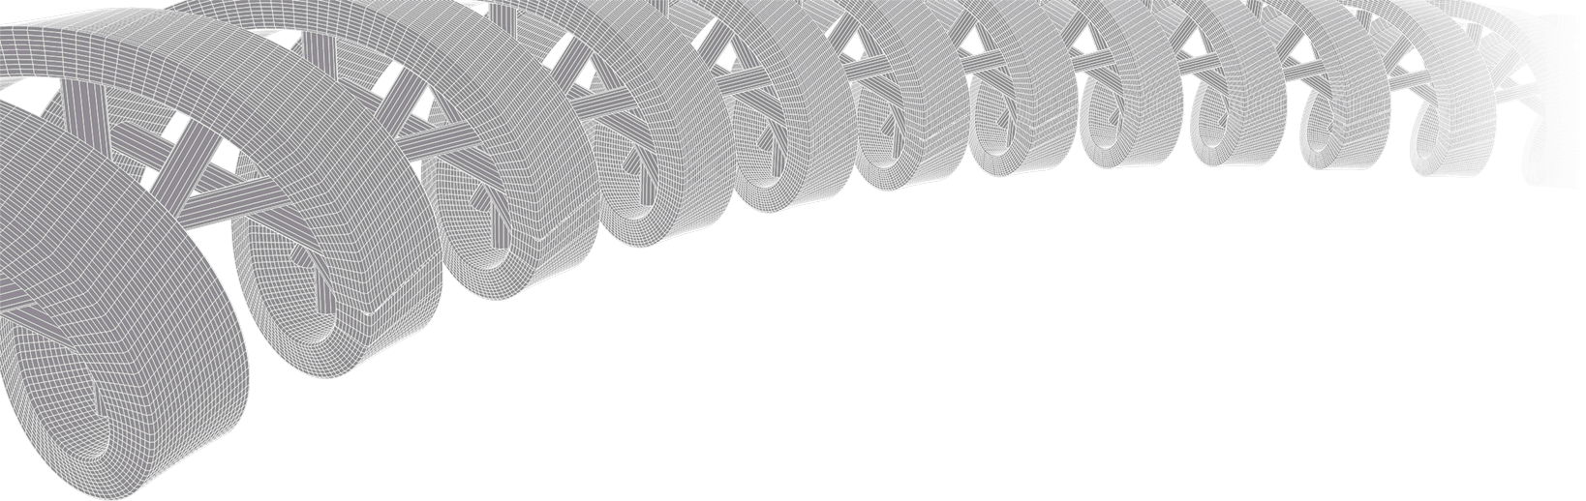

PMBIO Module 05 Somatic. Somatic WGS and Exome Variant Analysis
Malachi Griffith, Obi Griffith, Zachary Skidmore, Huiming Xia
Introduction to bioinformatics for DNA and RNA sequence analysis (IBDR01)
29 October – 2 November, 2018
Glasgow

Slide 2
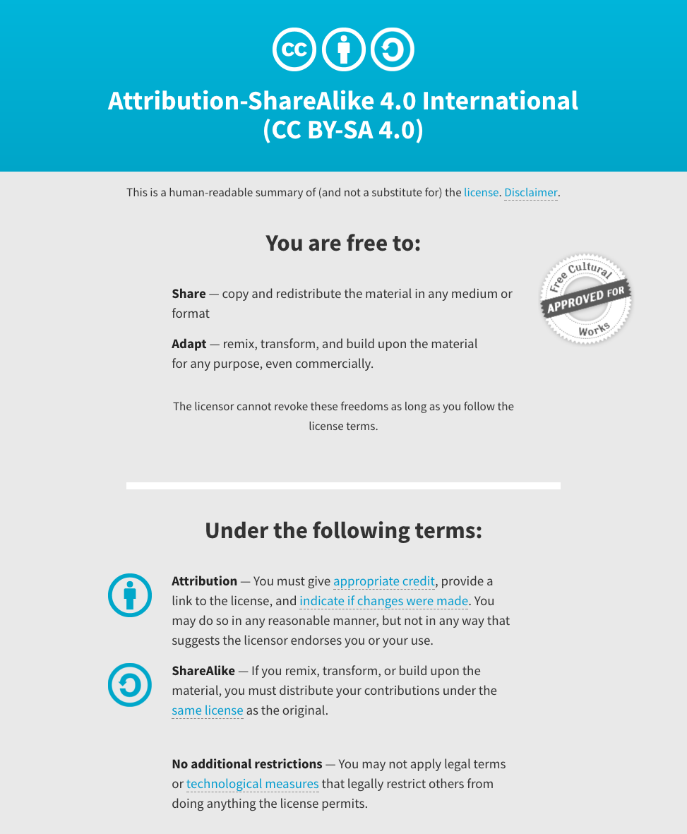
Notes:
Note there are two licenses if effect for this course.
All *content* (lectures, written materials, etc.) are made available under the Creative Commons Attribution-ShareAlike 4.0 International (CC BY-SA 4.0). (https://creativecommons.org/licenses/by-sa/4.0/).
All *code* (R scripts the website code itself) are made available under the MIT License (https://opensource.org/licenses/MIT).

Slide 3
Learning objectives of module 05: Somatic
Key concepts: Somatic variation, variant types (SNVs, small indels, CNVs, SVs, LOH), VCFs, variant allele fraction (VAF), purity estimation and tumor clonality
Compare and contrast the merits of exome and WGS data for variant calling
Compare germline and somatic variant calling strategies
Consider the features of major variant types detected in NGS data
Perform somatic variant calling of various types using tools specific to each type
Understand the basic features of the VCF format
Merge multiple VCFs into a single combined VCF
Perform variant filtering to identify a high quality set of variants
Annotate variants with respect to transcript annotations, population frequency, predicted function, etc.
Manually review variants of each type to better understand how variant callers use read alignment data to identify variants

Slide 4
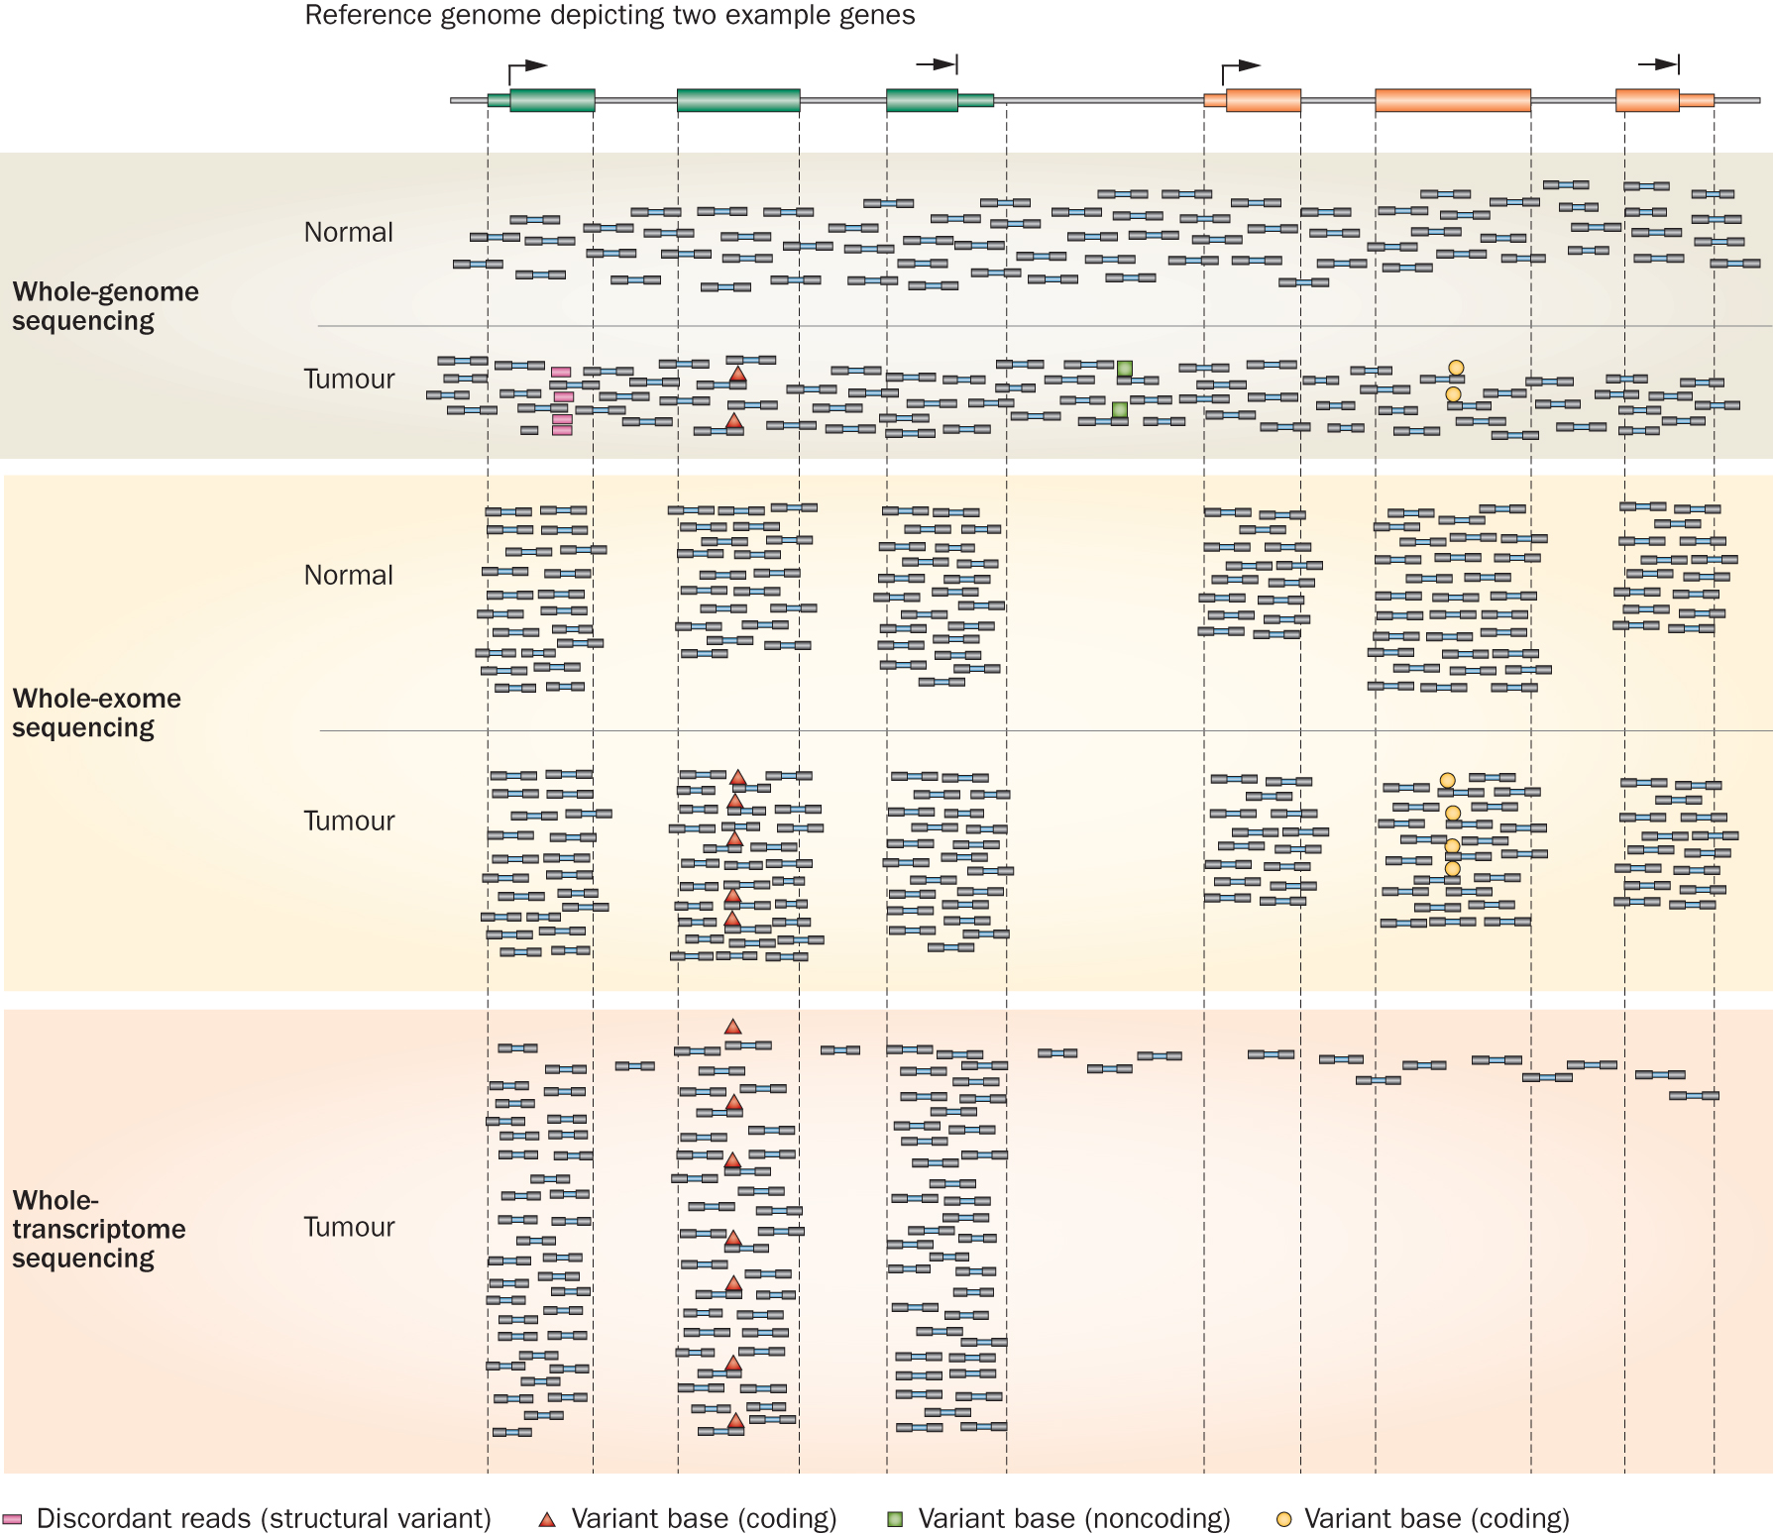
Whole genome, exome and transcriptome sequencing allows us to detect and confirm many different variant types
‘WGS’
‘Exome’
‘RNA-seq’
Notes:
Each of these three data types, whole genome, exome and transcriptome, brings something to the table.
Whole genome gives you broad, even, and relatively unbiased coverage across the genome.
Exome gives you more focused coverage but much greater depth over the exons for a much lower cost than whole genome
RNA-seq gives you a snapshot of the transcriptome.

Slide 5
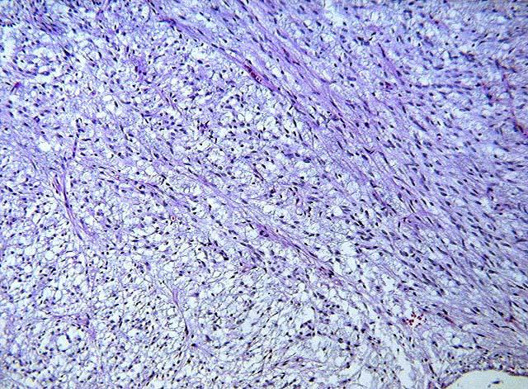
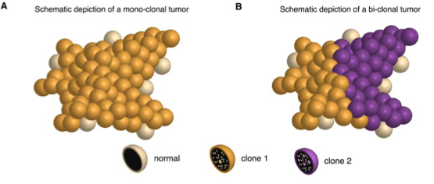
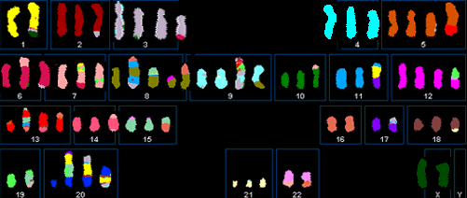
Tumors are often impure, heterogeneous, and aneuploid
Tumors are often impure
(contain normal cells)
Tumors are often genetically diverse collections of cells
Tumors may be aneuploid
Notes:
There are several factors that complicate sequencing and analysis of tumor genomes that are not encountered in germline sequencing projects.
Tumors are often impure, with normal cells mixed into the tumor cells. Tumors are often heterogeneous, containing complex genetically diverse collections of cells. Finally tumors can be highly aneuploid with major deviations from a diploid state
Each of these factors can make detection of somatic mutations more difficult and confound characterization of the clonal architecture of a tumor.

Slide 6
Somatic mutation vs. germline mutation vs. germline polymorphism
Somatic mutations are best distinguished by adequate sequencing of a matched normal
Affected and unaffected family members may help to determine origin of a germline mutation
Comparison of variants to variant databases can also help to classify variants as:
Germline polymorphisms
1000 genomes
Exome sequencing project (~6,500 individuals)
ExAC, Exome Aggregation Consortium (~60,000 individuals)
gnomAD browser (123,136 WXS and 15,496 WGS)
Germline mutations
OMIM, HGMD, PharmGKB, ClinVar
ACMG guidelines
Gemini
Somatic mutations
By inference if the mutation is not a common polymorphism (often a weak inference) or is a classic hotspot mutation

Slide 7
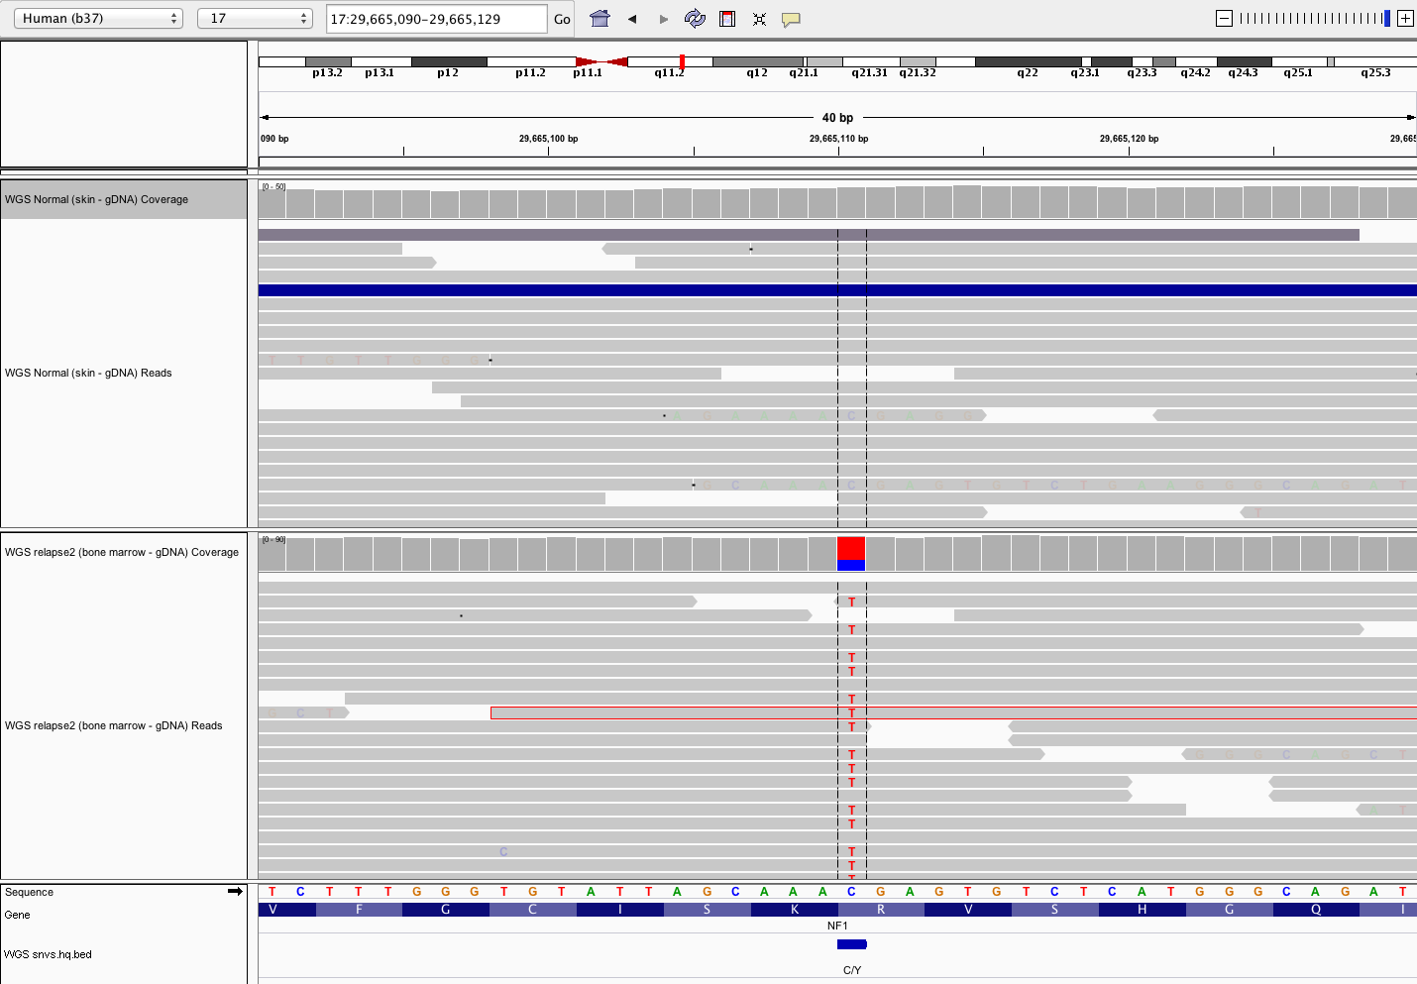
Single nucleotide variants (SNVs) appear as single base alignment discrepancies from reference genome
Variant allele frequency
Normal
Single read
Tumor
Variant supporting read
Reference sequence
Amino acid
Notes:
This example SNV was detected in an ALL case
This is the simplest type of genomic event to detect, describe, annotate. Of course in this case the frequency is close to 50%. Suggesting a heterozygous mutation present in 100% of the tumor cells. If the tumor is impure, or heterogeneous, possibly with multiple sub-clones, or the normal is contaminated with tumor cells, calling even this simplest type of variants gets much harder.
We currently use four somatic SNV variant callers: SomaticSniper+Samtools, VarScan, Strelka, and Mutect

Slide 8
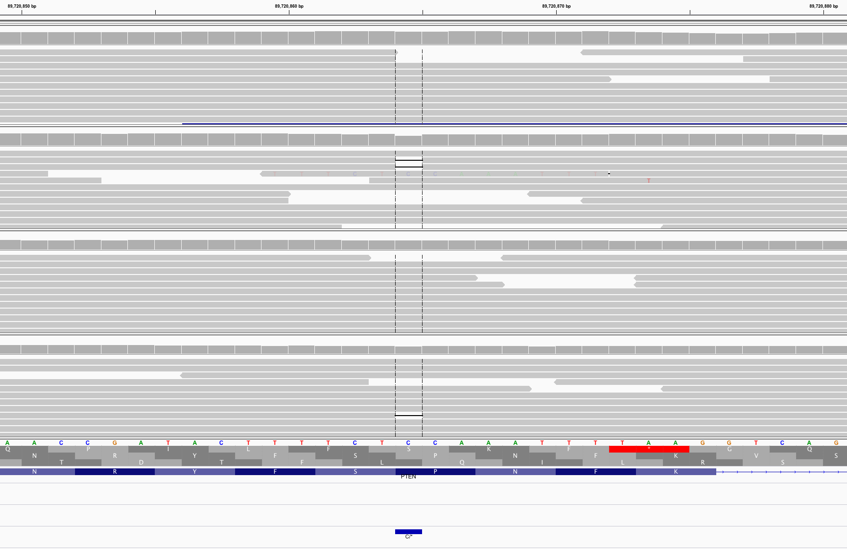
Small insertions and deletions (indels) appear as bases lost or gained in reads compared to reference
Normal WGS
Note drop in coverage
Tumor WGS
Normal Exome
Tumor Exome
Notes:
- Detected in a lung cancer case

Slide 9
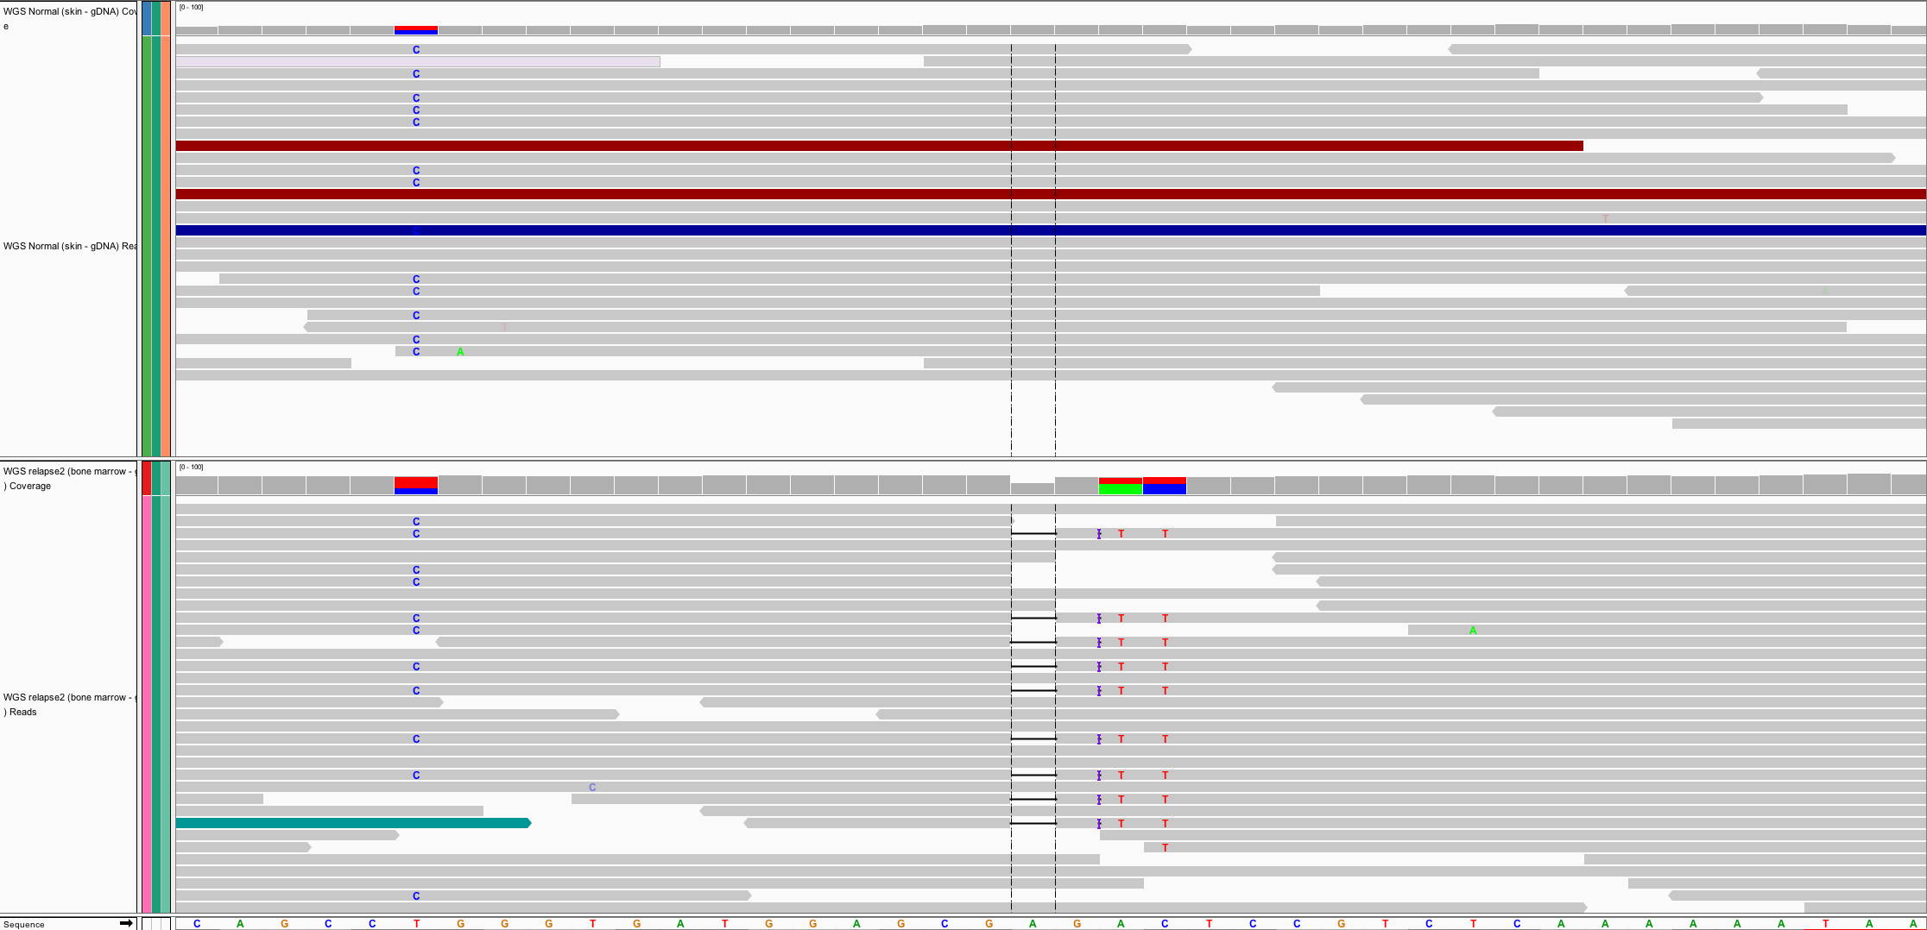
Somatic versus germline demonstration
Germline mutations
Present in egg or sperm
All cells of affected offspring
Heritable
Cause of familial cancers
Somatic mutations
Occur in non-germline tissues
Only tumor cells (breast, lung, blood, etc.)
Non-heritable
Cause of sporadic cancers
Normal
Tumor
Germline
Somatic

Slide 10
Variant allele frequency (VAF)
VAF = Variant reads / Total reads
Normal
VAF = 0/20 = 0%
Tumor
VAF = 14/20 = 70%
A heterozygous variant is expected to have VAF = 50%. Often not true due to sample purity, tumor heterogeneity, sampling error, alignment issues, copy number variation, etc.

Slide 11
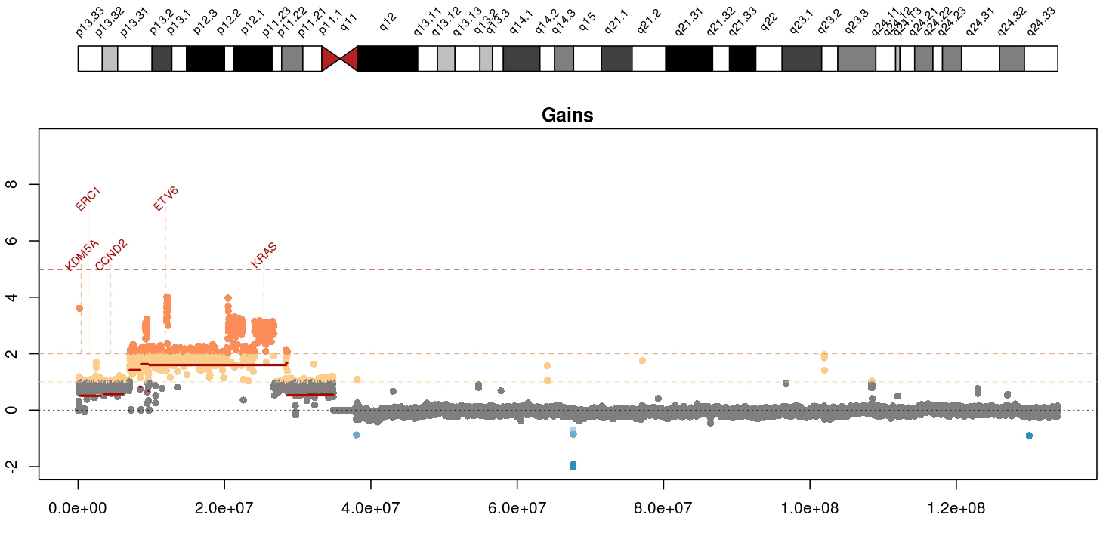
Copy number variants (CNVs) appear as deviations in alignment “depth” or “coverage”
Mean tumor-normal depth per 10kb window plotted
KRAS amplification in a metastatic breast cancer
Notes:
Whole genome data is exceptionally good a detecting copy number alterations in tumors. You essentially get a beautiful digital karyotype for each tumor. Here we see a complex amplification affecting KRAS and ETV6 and other critical cancer genes by both single copy and two copy gains.
We currently use cnv-hmm, CopyCat, and CnView for this kind of copy number analysis

Slide 12
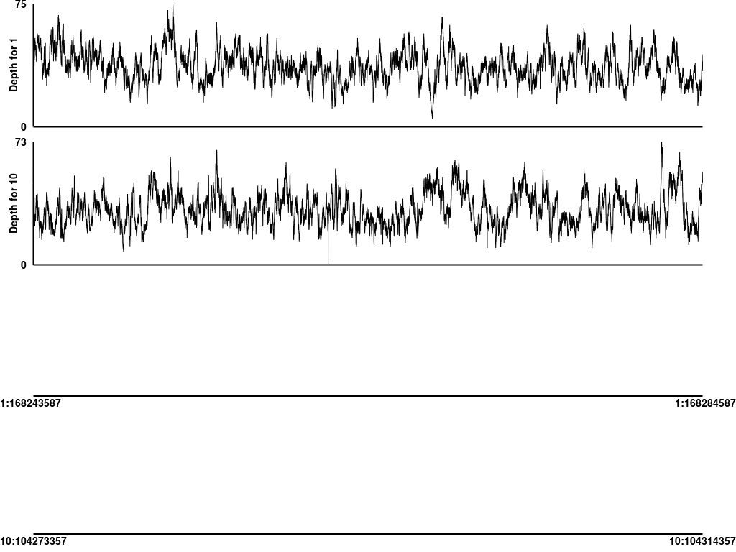
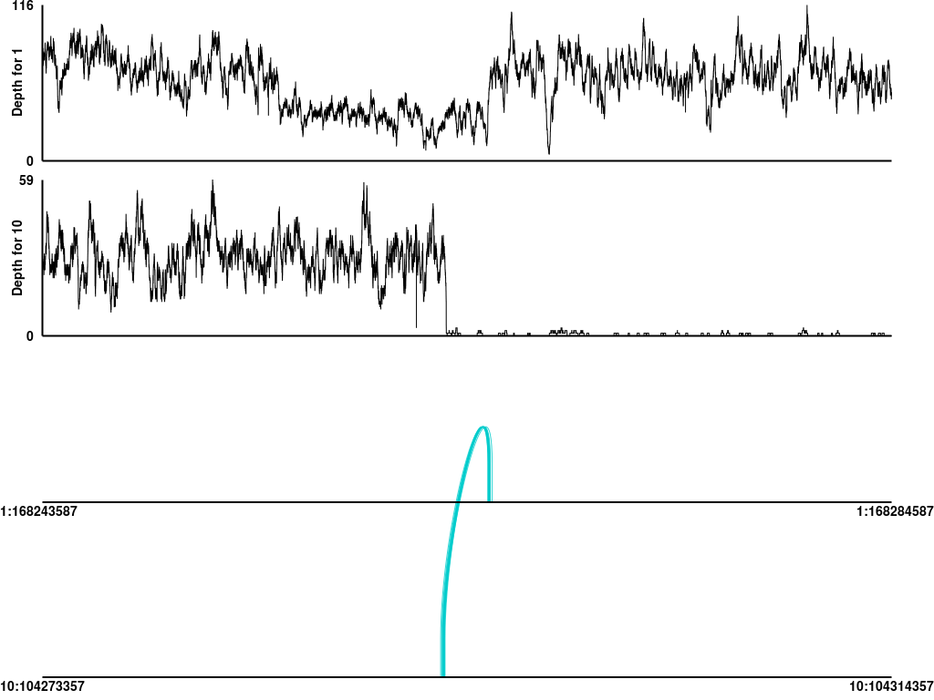
Structural variants (SVs) can be identified using a combination of coverage and discordant read alignments
Normal
Tumor
Coverage
Coverage
Chr1
Chr10
Chr1
Chr10
Discordant read support
Discordant read support
A Chr1-Chr10 (TBX19-SUFU) unbalanced translocation identified in an adult acute lymphocytic leukemia.
Notes:
Detected in an ALL case. One of the more difficult even types to predict are structural variants such as the interchromosomal translocation show here. Discordant read pairs, coverage patterns, and reads aligning across a junction breakpoint supporting a translocation involving chr1 and chr10 in this tumor. It is clearly somatic and not observed in the normal. While we can identify such events readily they are generally buried in a large pile of false positives. We also fear a large number of false negatives (but we have difficulty estimating this).
We currently use a combination of BreakDancer, SquareDancer, and Tigra-SV in our SV pipeline. We are in the process of incorporating lumpy-sv.

Slide 13
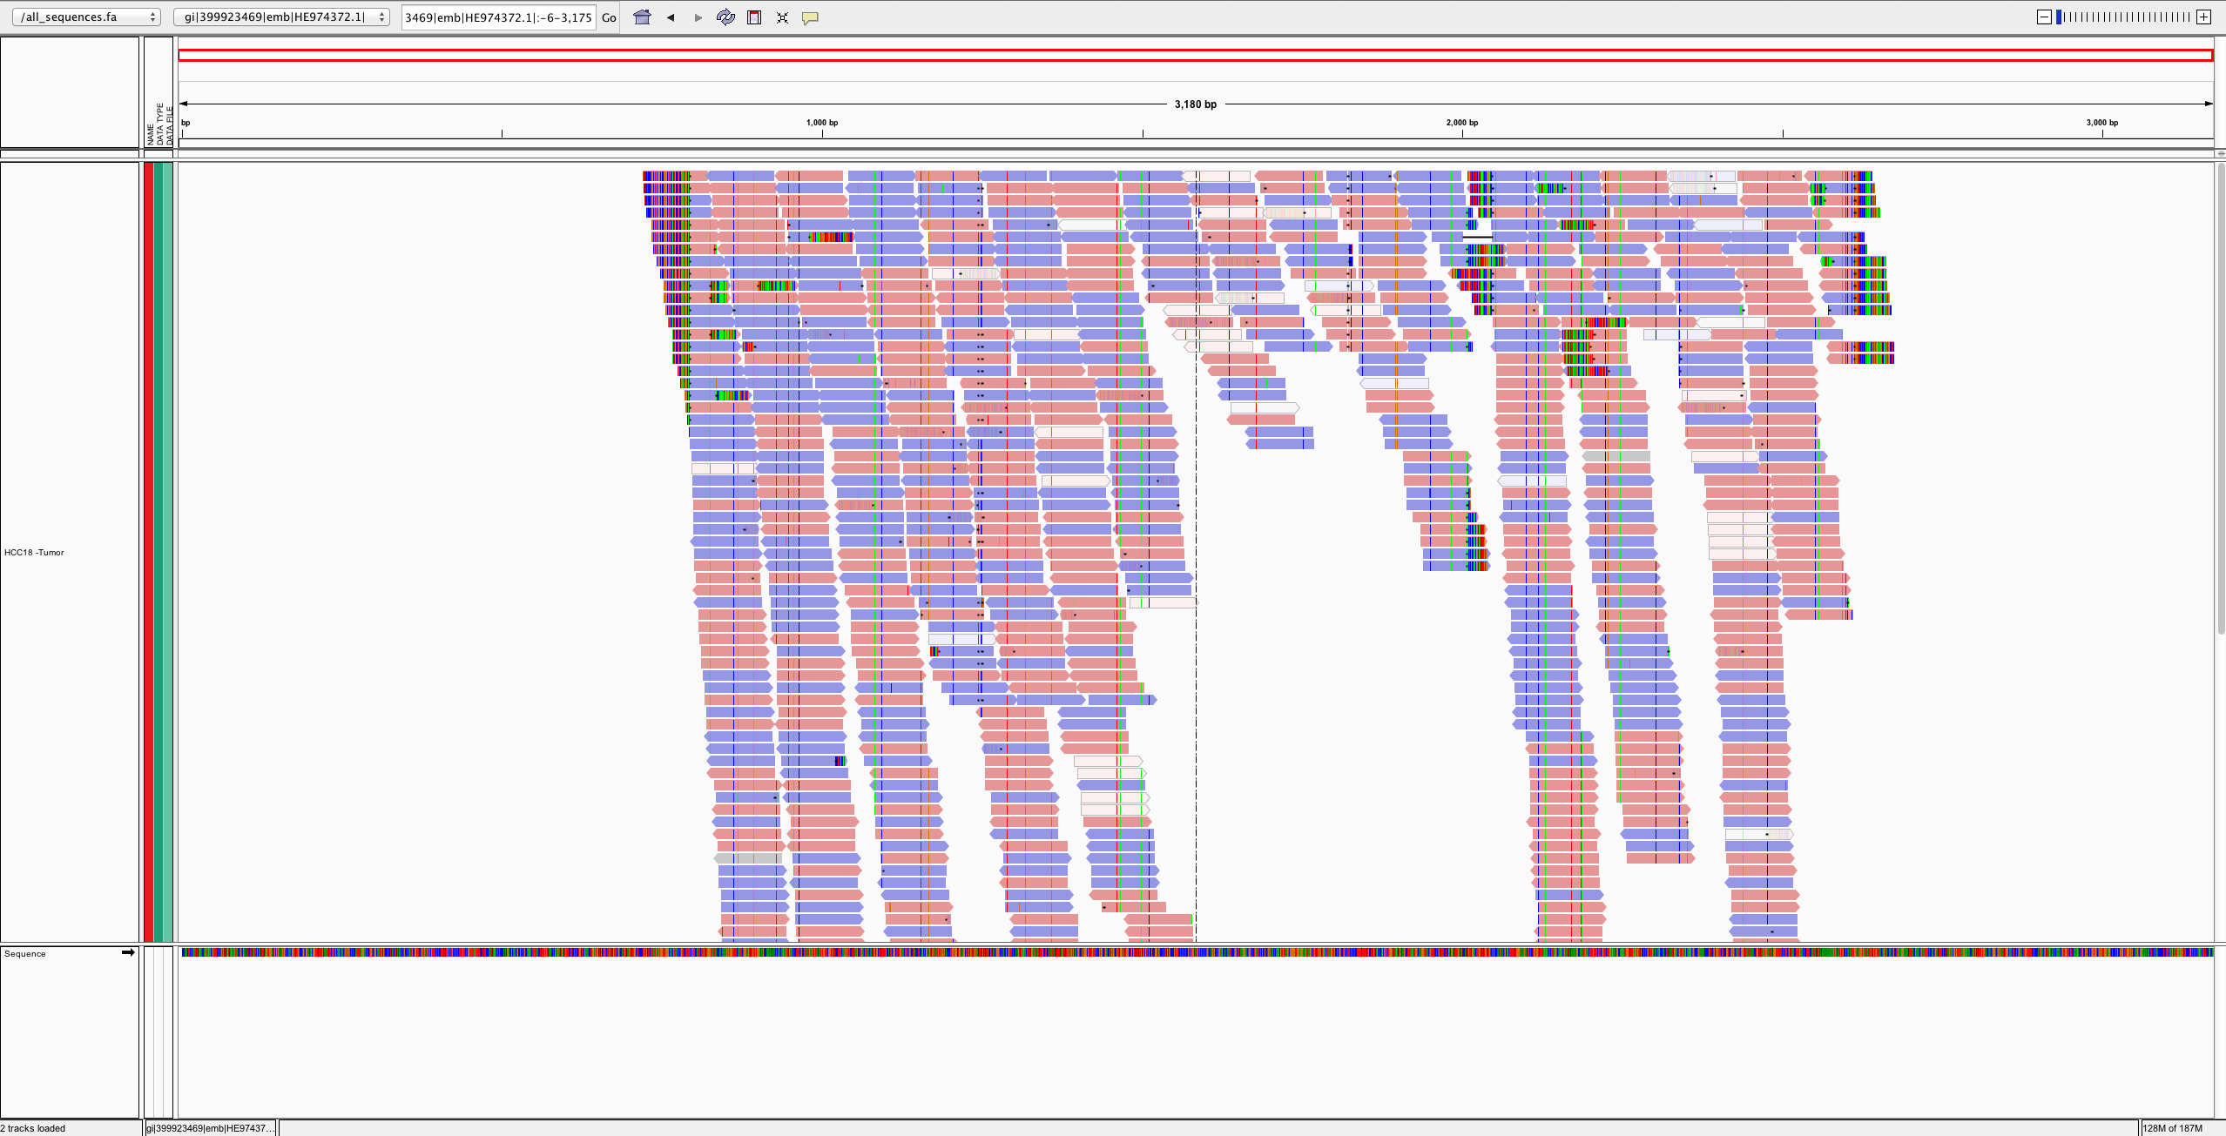
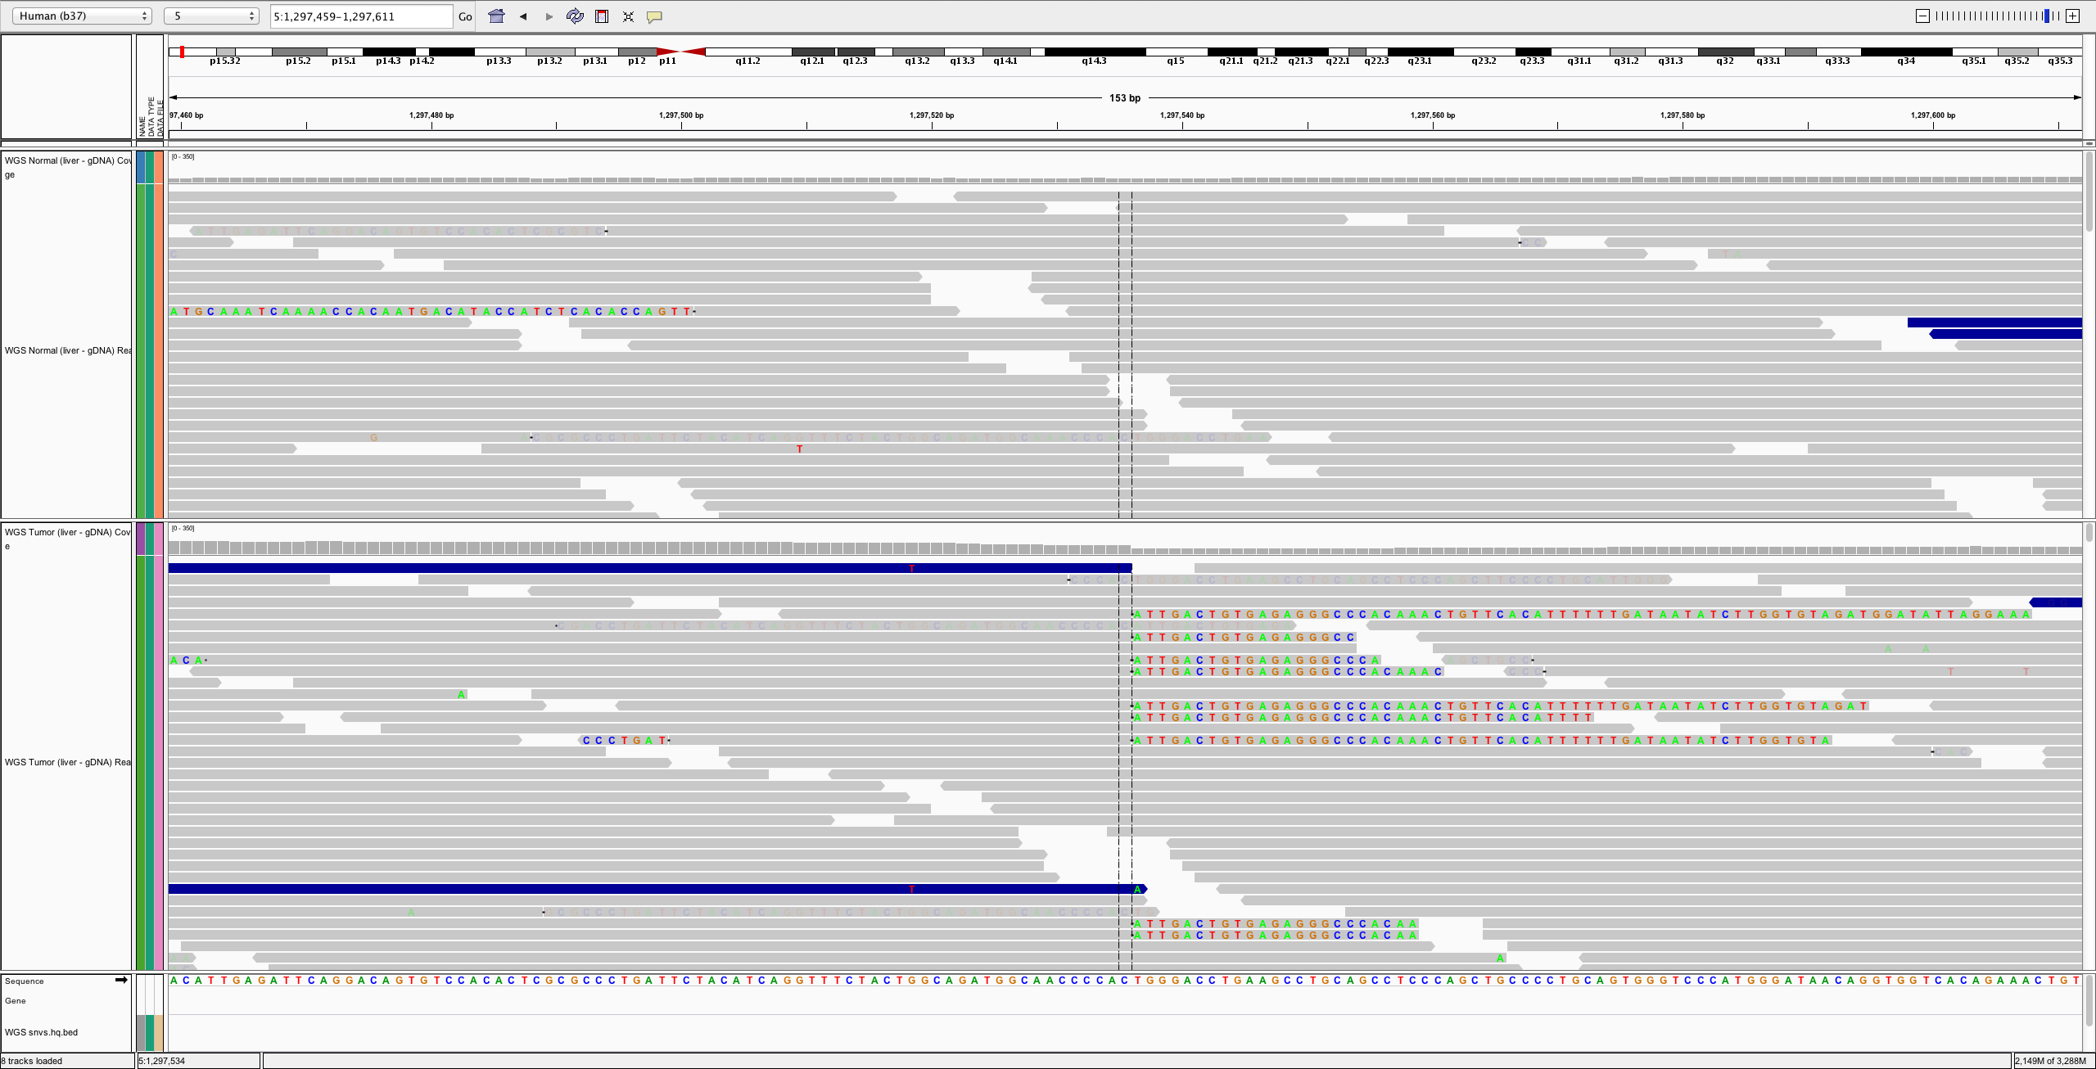
Viral integrations can be detected by analysis of WGS data (often with a custom reference)
Many reads align directly to viral genome
Soft-clipped reads in human reference help identify integration site
Notes:
- Detected in an HCC (liver) case

Slide 14
Expressed gene fusions can be identified by discordant read alignments spanning known exons from RNA-seq data
EP300-ZNF384
Encompassing (70)
RNA-seq read support
Spanning (258)
7
8
7
7
7
7
8
7
6
5
8
7
8
7
6
7
8
6
5
9
ZNF384 (NM_133476.4)
EP300 (NM_001429.3)
Slide from Chris Maher and Jin Zhang
12p13.31
22q13.2
Exons 1-8 of EP300 fused to exons 7-10 of ZNF384 in head-to-tail fashion.
Notes:
Here we have an expressed gene fusion detected by RNA-seq detected in an ALL case.
These events are detected by mining RNA-seq alignments for cases where both encompassing (or discordant) read pairs and fusion junction spanning reads support a geneA to geneB fusion.
As with detecting structural variants in the DNA data we know that overall we are not doing a great job of identifying these things. The current state of software packages for these events leaves a lot to be desired. We use ChimeraScan and Integrate. But we have also evaluated tophat-fusion, defuse, and others.

Slide 15
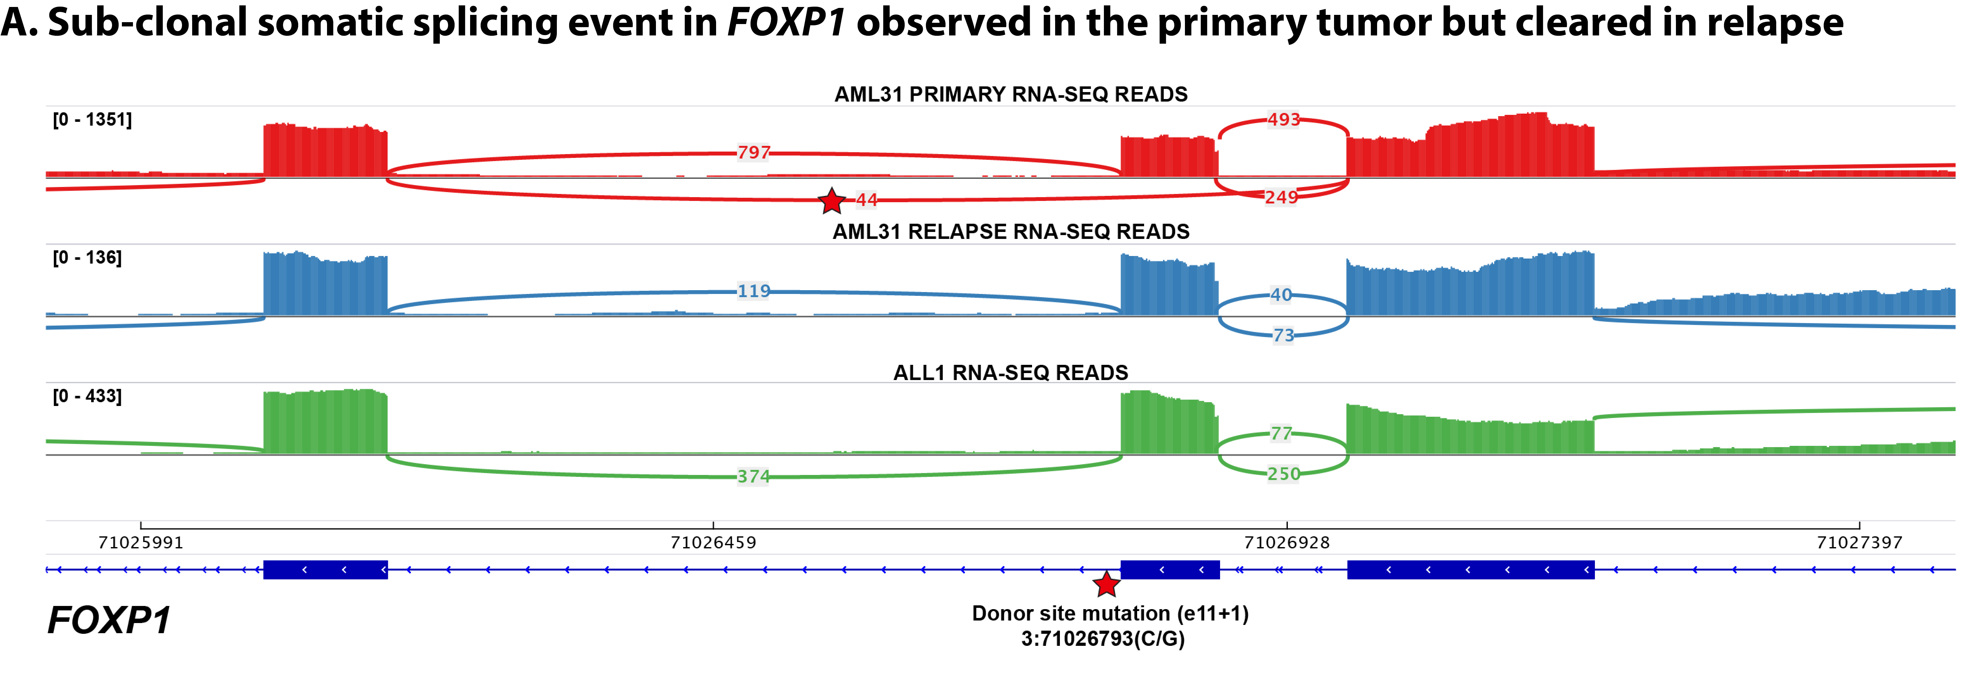
RNA-seq can also reveal the splicing consequence of somatic mutations detected in WGS
Splice site mutation
Read alignments support the skipping of affected exon
We created ‘RegTools’ to help characterize these kinds of events
Notes:
By integrating whole genome and transcriptome data we can start to test hypothesis for the splicing or regulatory effect of variants beyond those that are predicted to result in a direct amino acid substitution.
For example, in this AML case we found a somatic mutation near a splice donor site in a relapse tumor sample. In the RNA-seq data for this sample we see corresponding skipping of the affected exon. We do not see this exon skipping in other samples that lack the mutation.
We are currently working on tools to automate this type of analysis.

Slide 16
Tumor genome analysis will typically reveal dozens to thousands of alterations of multiple types
SNVs
SVs
Indels
CNVs
Gene expression
Notes:
From an end users perspective what you get out of the GMS is summarized results and visualizations that help you interpret and mining NGS data
The following slides show some examples of each of these types of predictions. They are listed in order from most developed and reliable to least developed and most experimental

Slide 17
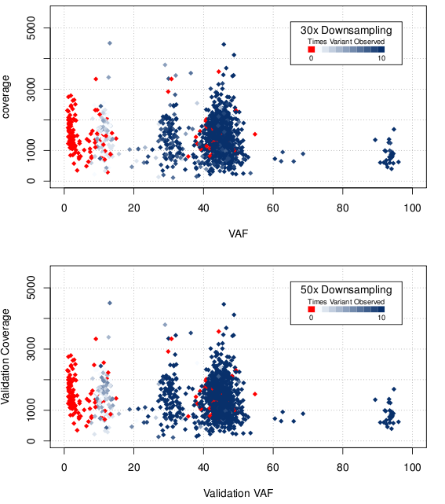
Depth is critical to overall sensitivity of somatic variant discovery
Notes:
We made many interesting observations by analyzing this data. Here is one vignette that illustrates how critical depth was to overall sensitivity of variant discovery.
Remember that we relied on the initial ~350x WGS data to discover putative variants in the first place. If we can’t discover them we can’t target them for capture and further sequencing.
We found that if we randomly down-sampled this WGS data back to 30 or 50x and attempted variant calling again, quite a few platinum variants were not called consistently. Basically everything below 20% VAF in the primary tumor is lost at 50x or lower coverage. And even some higher VAF variants are missed.
This primary tumor happens to be 90% pure (the relapse is 32%). So this problem would be much worse with purity levels that are commonly seen in clinical tumor samples.

Slide 18
Use of multiple variant callers can improve sensitivity and accuracy
Notes:
If you are planning to skimp on WGS depth you might consider using a combination of variant callers.
Taking the union will improve sensitivity at the cost of getting lots of false positives. However, we have found that simple intersection or partial intersections can give you a pretty good balance of sensitivity and accuracy.

Slide 19
One goal of somatic variant detection is to enable precision medicine targeting of driver mutations
1980s: Development of Targeted Therapies
2000: Human Genome Sequencing Project
2001: FDA Approval for Imatinib in BCR-ABL1 CML
2014: FDA Approval for BRCA Testing
2017: FDA Approval of Keytruda for MSI tumors
BRAF -> V600E -> Melanoma -> Predictive -> Vemurafenib
ERBB2 -> Amplification -> Breast -> Predictive -> Traztuzumab
EGFR -> L858R -> Lung -> Predictive -> Erlotinib
ALK -> Fusions -> Lung -> Predictive -> Crizotinib
EWSR1-FLI1 -> Fusions -> Ewing Sarcoma -> Diagnostic
DNAJB1-PRKACA -> Fusions -> flHCC -> Diagnostic
VHL -> Loss of function mutations -> Kidney -> Predisposing
… an increasingly long tail of rare but clinically relevant variants
Erica Barnell
Notes:
Notes on examples:
BRAF -> V600E -> Melanoma -> predictive?
EGFR -> L858R -> Lung -> predictive?
EGFR -> T790M -> Lung -> predictive?
ALK -> Fusions -> Lung -> predictive?
ERBB2 -> Amplification -> Breast -> predictive?
EWSR1-FLI1 -> Fusion -> Ewing Sarcome -> Diagnostic?
Secondary mutations in BCR-ABL1 that confer resistance?
PTEN Loss perhaps?
I would argue BRCA mutations should also be counted. Also, we are at the point where ER/PR/HER2/KI67 testing by RNA is cheaper and more accurate than IHC and really *should* be the clinical standard. Rolling out in less developed countries that don't have legacy dependency on IHC. NTRK fusions and inhibitors seem likely to have a wide impact
ERBB2 kinase domain mutations in breast cancer, while rare, are clearly clinically relevant
KIT mutations in GIST and some other tumors guide standard of care
There's about a dozen genes with mutations that inform FDA approved treatments and guidelines according to oncokb. Not as many as we would like but to say CML is the only example is really weird
I think the problem is that many of these are not being run routinely in the clinical setting outside of select academic hospital settings. But this is more a problem with slow/conservative clinical adoption and default resistance of insurance providers. It will take a few more years beating them over the heads with data. OHSU is planning to roll BRCA testing out to all patients in their system (hundreds of thousands or millions planned). Mary Claire King has been preaching this for years but think about how long we've known (or could impute) of the importance/value of this. Things just move show.
MSI -> nsclc -> nivolimab
Dnajb1-prkaca -> flHCC -> diagnostic
BTK -> C421 -> CLL -> predictive of resistance
Special subset of heme malignancies are defined by eosinophilia and pdgfra/b and one other gene.
Alk fusions are highly targetable.
Her2 targeting with trastuzumab changed the picture for these patients as far as I understand. Both of these are heavily represented in CIViC, and played a large role in MATCH basket trial. The data seems very much there in some of these trials, so it should only be a matter of time for it to be more accepted.
I noted the MSI (non gene entity) example, and think we should perhaps prioritize non gene entities a bit higher in our upcoming goals.
In general the variant clinical interpretations should help us address this topic more effectively. Maybe 5 years from now someone asking that same question could be directed to CIViC as part of the answer.
Prosigna (Produced by Nanostring) is a panel of ~50 RNA transcripts that predicts breast caner recurrence and is now included in international guidelines for breast cancer surveillance
Veracyte produces a bunch of genomic diagnostics including Afirma (Fine Needle Aspiration analysis to diagnose thyroid malignancy), Percepta (lung cancer diagnosis), and Envisia (IPF diagnosis)

Slide 20
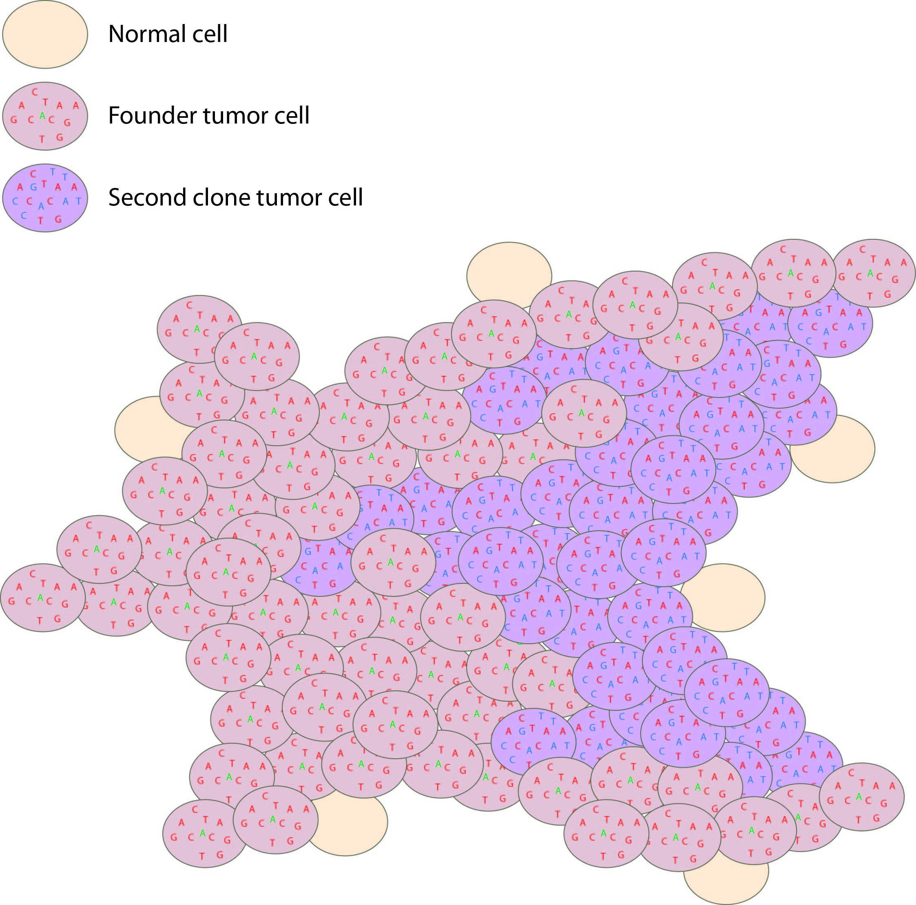
Dominant clone vs. sub-clonal (and driver vs. passenger)
Tumor variant allele frequency
Proportion
NF1
Read coverage (X)
WGS data
Tumor variant allele frequency
Tumor variant allele frequency

Slide 21
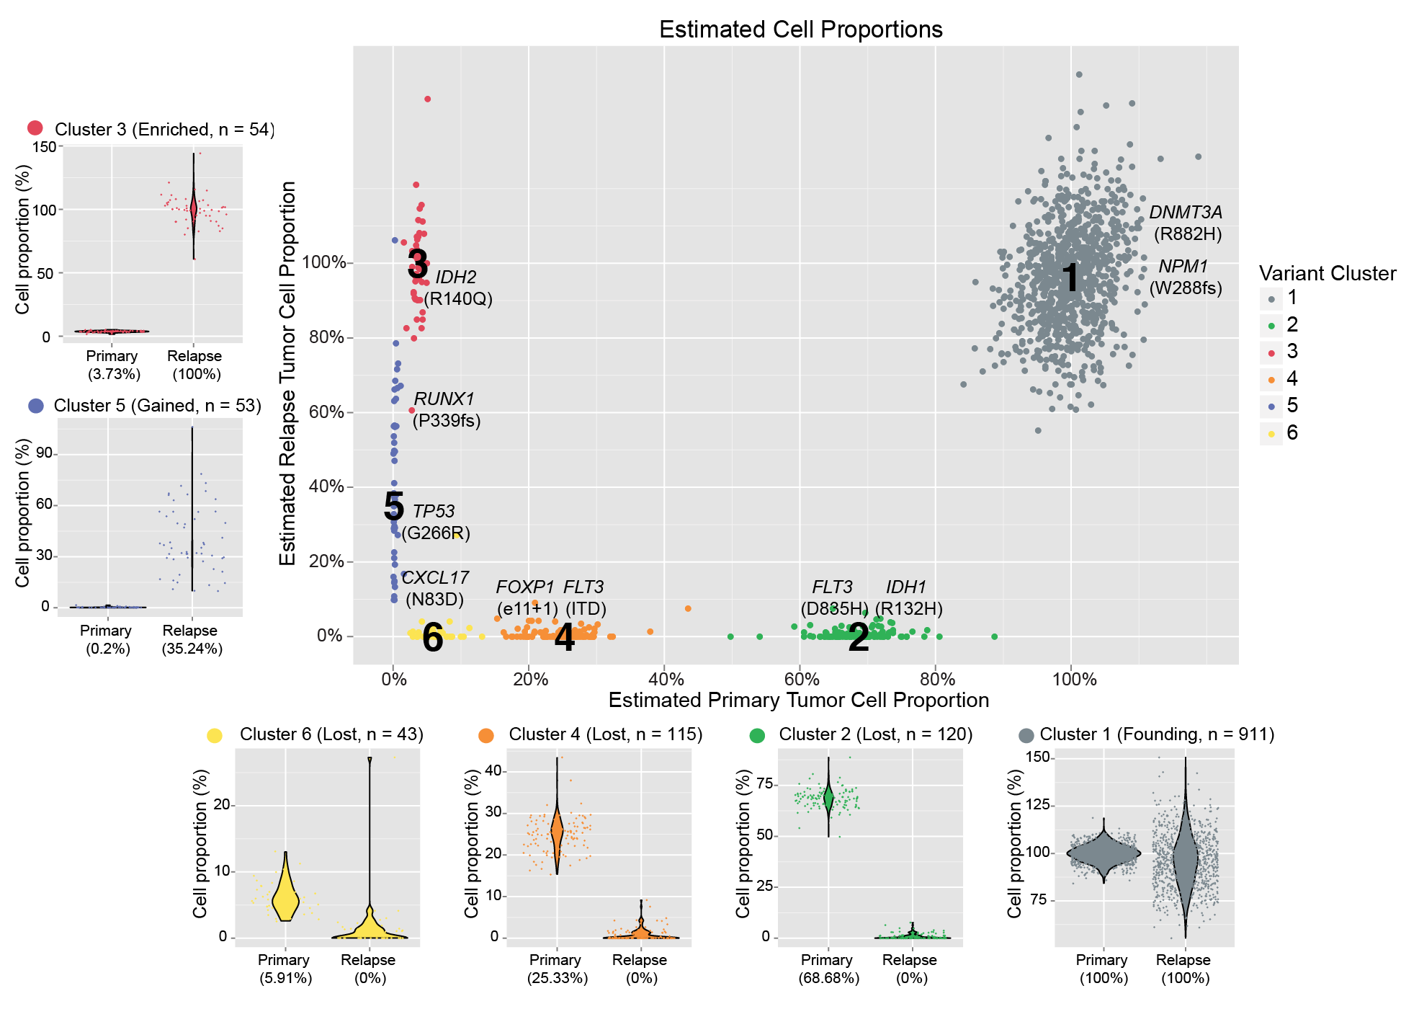
Profiling over time can expose complex clonal evolution
Notes:
If we overlay each of these mutations on the rest of the platinum variants and use a clonality inference tools like SciClone we can resolve 6 different sub-clones, each with a couple driver mutations present. Except sub-clone 6. Based on our experiences so far we probably still haven’t sequenced deeply enough to find a driver event in that sub-clone yet.
You can see how in each of the surrounding plots, a shift in VAF distribution is occurring between primary and relapse.

Slide 22
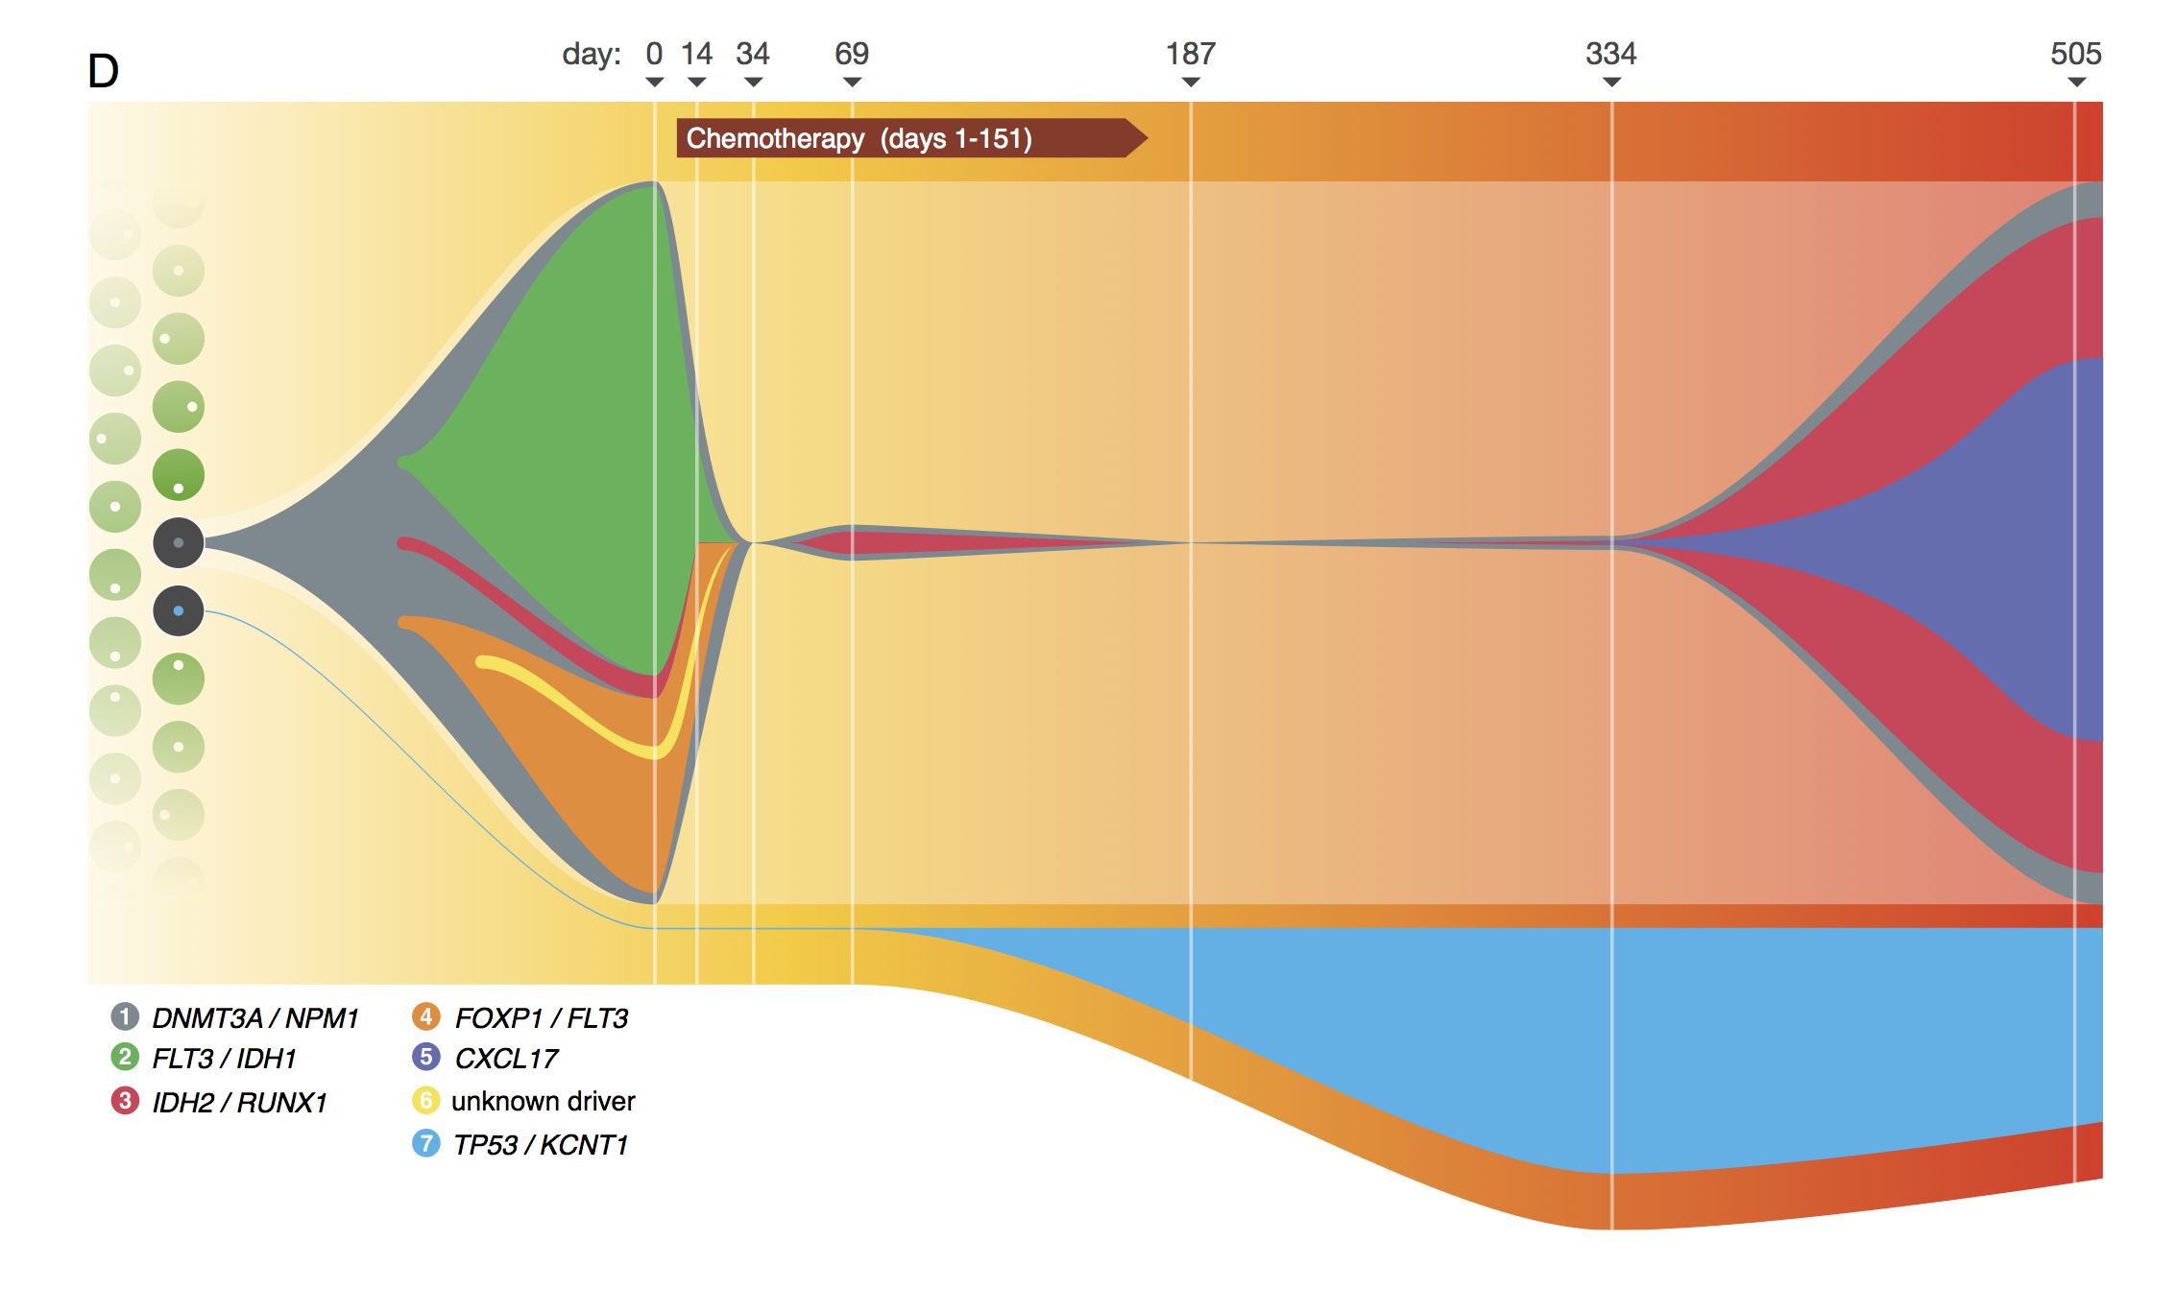
Dramatic shifts can be observed
FOXP1
DNMT3A
IDH2
TP53/KRT1
FLT3/IDH1
Notes:
In other words, there appears to be a completely independent clone with a TP53 mutation that expands during treatment while the AML harboring DNMT3A shrinks.
At the time of the relapse, there are two AML sub-clones derived from the found clone and an independent clone that we couldn’t tease apart until well saw the time course data.
It looks like this patient, now in a sustained second remission, may be harboring this TP53 mutation in a significant fraction of their blood. The significance of is not totally clear at this stage but one can certainly imagine possible predictive value to all of the information buried in the primary tumor…

Slide 23
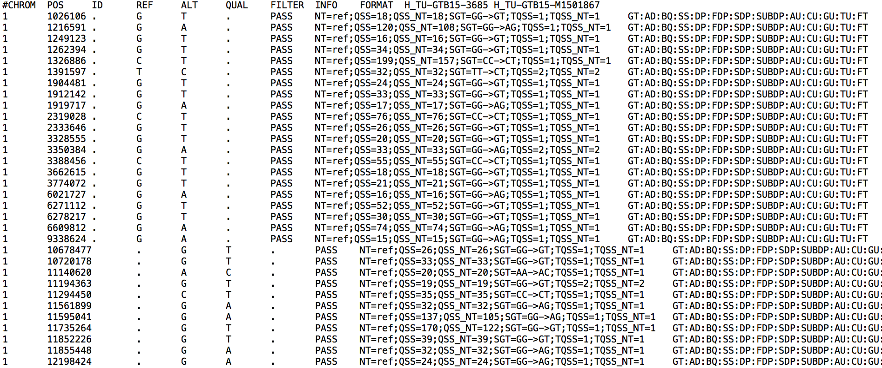
Most variant results are now represented in VCF format. Calling variants is complex but interpreting is harder
Details of the VCF file format: hts-specs, VCF-v4.2.pdf

